Slide 1

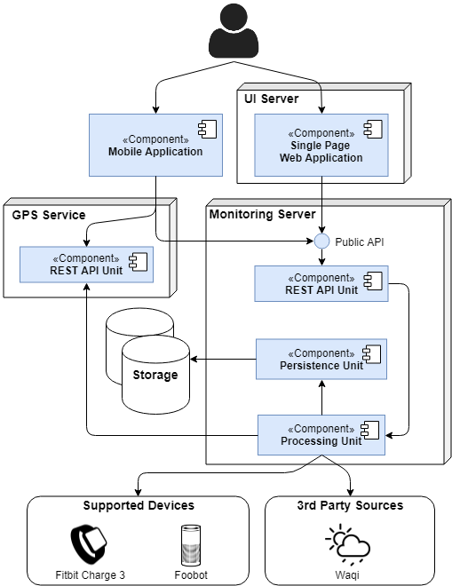
Abstract
The proliferation of mobile devices for monitoring vital signs and physical activity is enhancing the emergence of a new healthcare paradigm.
We suggest the integration of smart devices with air quality monitors in a personal healthcare system to answer some limitations of similar solutions.
ContinuousCare is all about helping citizens better understand their health and body activity, aiding professional doctors with analysis tools and making available valuable data for external systems.
Methods
We set out to support a data source of each nature and adopted a phylosophy of storage dedicated to temporal records in order to prove the concept of continuous health monitoring through easily available smart devices.
The intention was also to show the impact of the environment that people are exposed to on the symptons detected, so the air quality monitors were completed with a geolocation tracking service. This, along with a consideration for our users’ experiences and moods, denoted our means of tackeling this challenge.
Fig. 1 - Architecture diagram of the solution.
Conclusion
As intended, ContinuousCare promises to aid any user interested in perfecting their lifestyle and monitoring the surroundings. It now has the potential to develop into a more intelligent and specific system capable of detecting dangerous behaviours and hazardous environments.
Results
ContinuousCare encompasses:
A public REST API with 26 end-points, including the export of bulk anonymous data for analysis
A WebApp supporting accounts for regular users and medical personnel, with dedicated analysis tools
A MobileApp serving not only as a GPS source, but also as an offline installation guide
A system test-proven with a load of 100 users while meeting all performance requirements
References
An Android App for Geolocation Based Health Monitoring, Consultancy & Alarm System. Tartan, Emre, et al. IEEE, Tokyo, 2018.
Angel-Echo: A Personalized Health Care Application. Ma, Mengxuan, et al. IEEE, Philadelphia, PA, USA, 2017.
Health monitoring systems using IoT and Raspberry Pi. Pardeshi, Vivek, et al. IEEE, Bangalore, India, 2017.

Slide 2
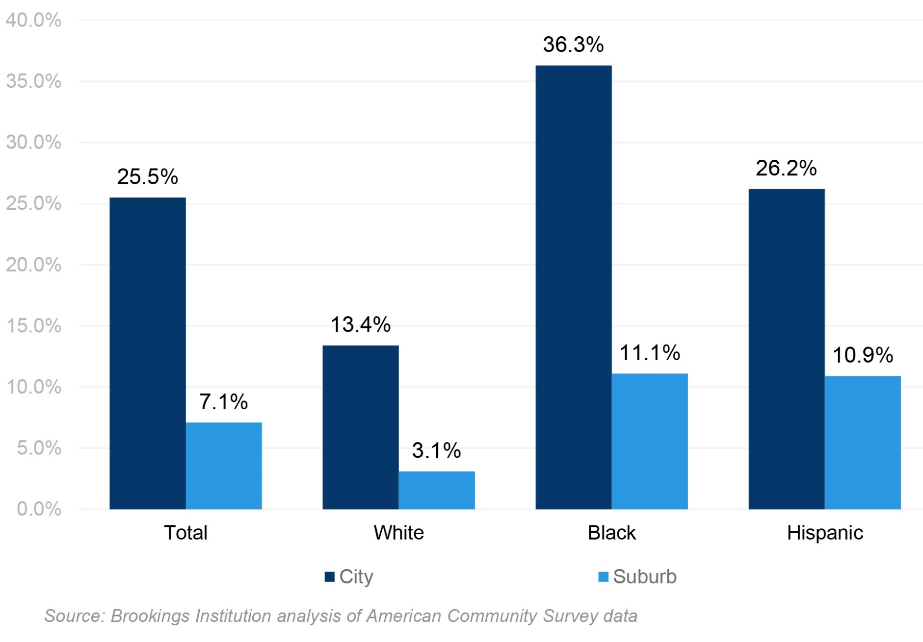
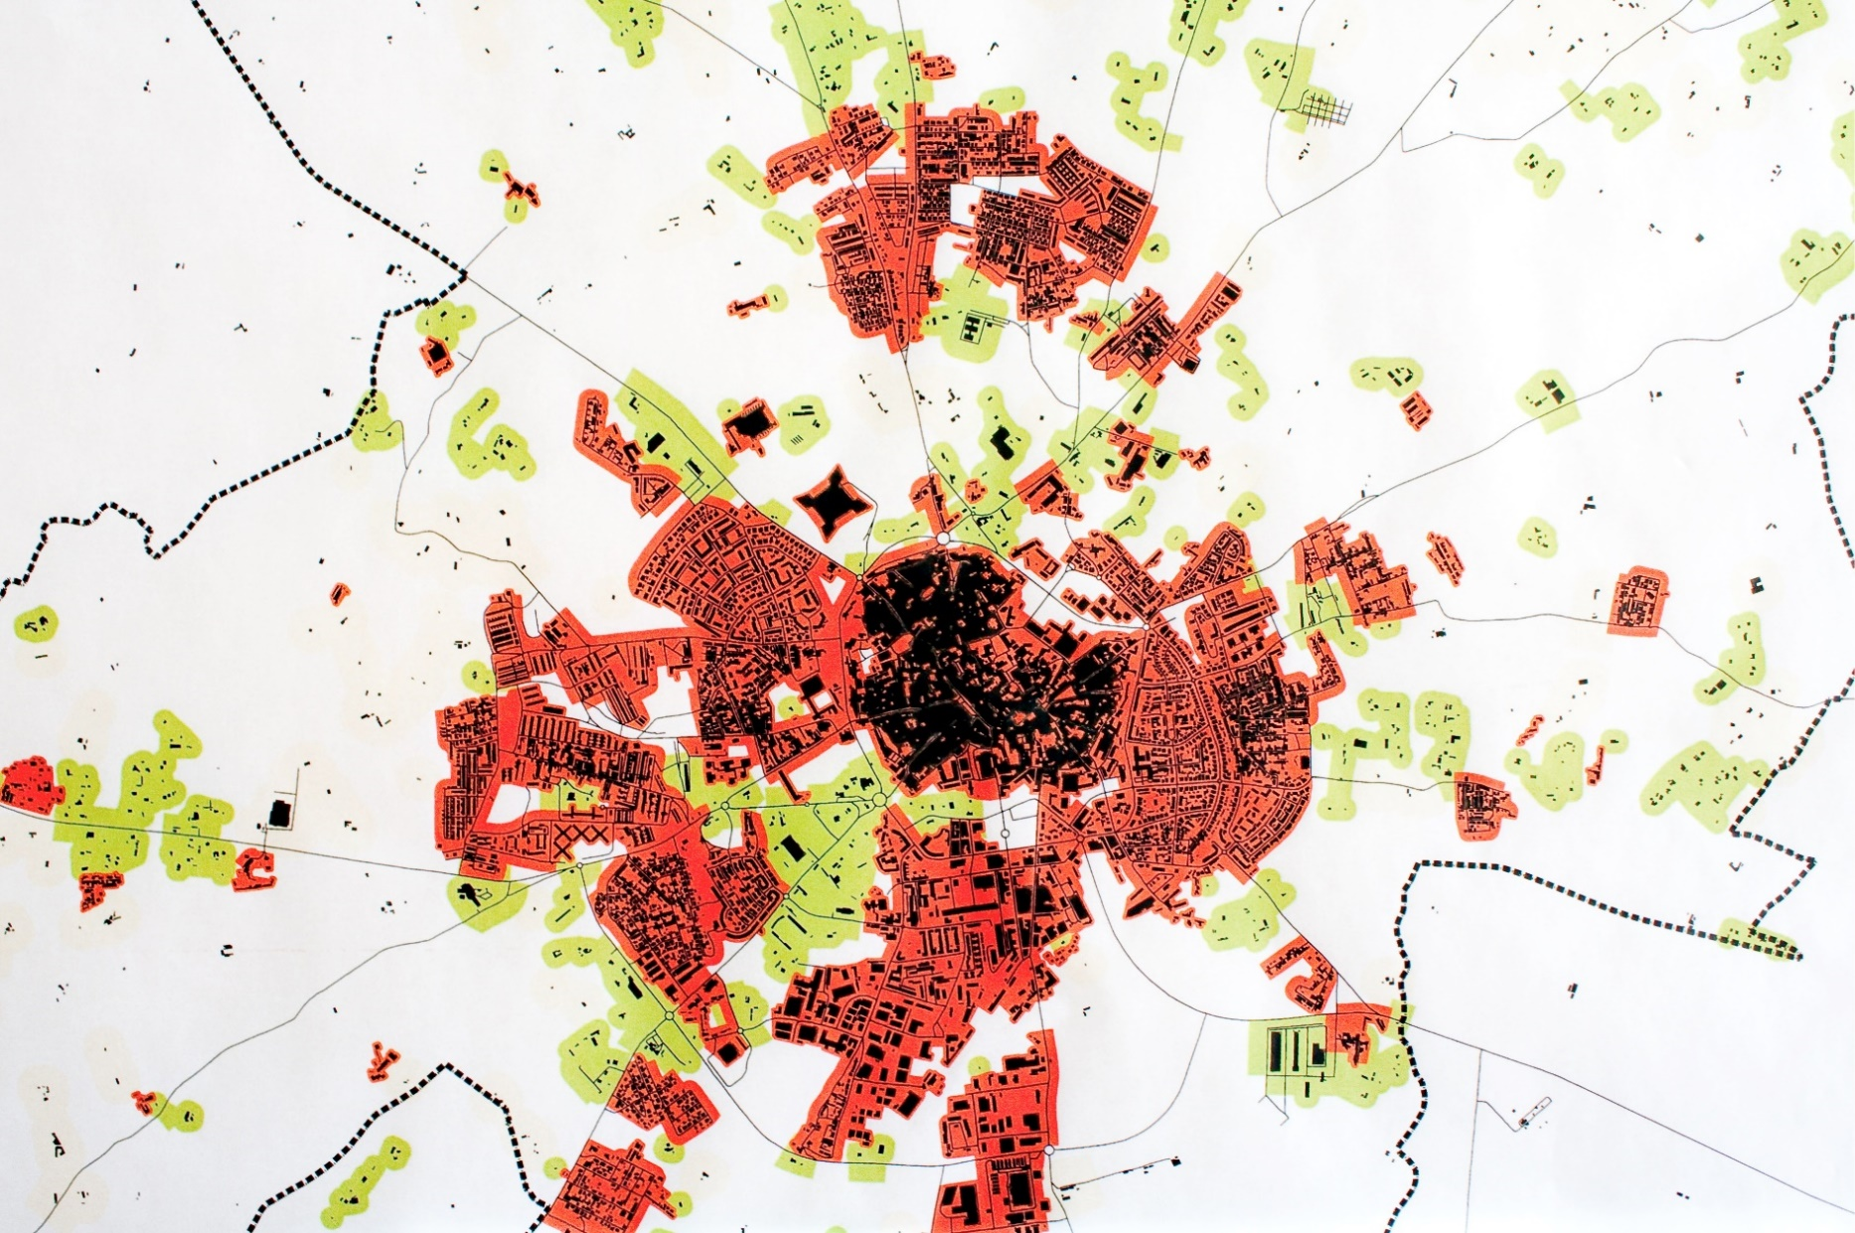
Connecting the line integral around a simple closed curve with a double integral
ORIENTAÇÕES:
Os autores são livres para organizer o conteúdo como entenderem.
Língua: português ou inglês.
A disposição dos elementos do cabeçalho, as margens e tipos de letra devem ser respeitados.
O poster pode ser editado noutra ferramenta, que não o PowerPoint, desde que se vá de encontro ao resultado pedido.
Cor azul para títulos:
Escuro: RGB(41, 73, 135); Claro: RGB(0, 158, 221)
Tipos (de letra):
Títulos e destaques → Noto Sans Disp SemBd
Corpo do texto → Noto Sans Disp Light
(outros tipos da família Noto Sans Disp podem ser usados)
→ Para melhores resultados, pode ser necessário instalar no sistema o pacote de fontes “Noto Sans Display” que pode ser obtido em https://www.google.com/get/noto/ [não é preciso todo o vasto conjunto de tipos Note, apenas a família Noto Sans Display]
Nota: activar View > Guides para ver melhor os limites das margens.
O título deve ter uma linha (preferencialmente) ou, se necessário, duas linhas.
Não alterar posicionamento das textboxes
Cristina Silva, Joana Maria, Quinato Rafael, Joana Maria, Quinino Rafael, Quinino Rafael Almeida
Orientador: Prof. José Quinino
Incluir na última linha:
designação da unidade curricular, ano e curso
ou
Designação do grau e curso, para as dissertações/teses, e.g.: Mestrado em Engenharia Informática
Projeto em Engenharia Informática, 3º ano, MIECT.
Abstract
In 1828, the English mathematician George Green (1793-1841), who up to his forties was working as a baker and a miller, published an essay where he introduced a formula connecting the line integral around a simple closed curve with a double integral. Within years, this result turned out to be useful in many fields of mathematics, physics and engineering. Generalizations of Green’s theorem have chosen different directions, and are known as the Kelvin-Stokes and the Gauss-Ostrogradsky theorems.
Se possível, em gráficos, usar a palete de cores do poster (azul escuro, azul claro, cinza)
Fig 3- Some longer caption here, explaining the main findings in the illustration. Keep the color pallet if possible. This work received The Grunvald-Letnikov award for the best student paper – theory
Produção do PDF da versão final:
atenção à qualidade das imagens originais: pelo menos 300dpi (cores) ou 600dpi (escala de cinzentos).
o Office 2016 permite exportar PDF (File>Export>Create PDF). Selecionar: “Optimize for Printing”
Conferir que o PDF produzido tem a qualidade pretendida: abrir num visualizador de PDF e fazer zoom a 400% → confirmar o aspeto dos vários elementos do poster.
Methods
On that day, L’Hopital wrote a letter to Leibniz, where he asked about Leibniz’s notation of nth order derivatives. L’Hopital wanted to know the result for the derivative of order n = 1/2. Leibniz replied that “one day, useful consequences will be drawn” and, in fact, his vision became a reality. Katugampola, Klimek, and many results of classical analysis were analysis were analysis were Katugampola, Klimek, and many results of classical analysis were analysis were analysis were.
Results
Different forms of fractional derivative operators were introduced, e.g., Hadamard, Riemann–Liouville, Caputo, Riesz, Cresson, Katugampola, Klimek, and many results of classical analysis were extended to the noninteger case. different forms of fractional derivative operators were introduced, e.g., Hadamard, Riemann–Liouville, Caputo, Riesz, Cresson, Katugampola, Klimek, and many results of classical analysis were extended to the noninteger case.
On the Inter-national Conference “Fractional Differentiation and Applications”, that took place in Nanjing, China, from 14th to 17th May 2012 (see Fig. 1).
Coluna vertical (à esquerda) deve ficar vazia
The award highlight
Some highlight is a box to stress a key point or summarize findings. Could go like this.
This work received The Grunvald-Letnikov award
The Grunvald-Letnikov award is great
Área para o logo do projeto/trabalho, se aplicável.
Deve ficar dentro da coluna, acima dos logos instituicionais
Fig 1- Caption goes here.
Conclusion
This work received The Grunvald-Letnikov award for the best student paper – theory, on the Inter-national Conference “Fractional Differentiation and Applications”, that took place in Nanjing, China, from 14th to 17th May 2012 (see Fig. 1).
References
Pinho, C., Madaleno, M. and Santos, H. (2013), “The usefulness of financial analysts reports: A content analysis approach”, International Journal of Management (IJM), June, Vol. 30, No. 2, Part 2, pp. 631-648; ISSN: 0813-0183.
Procurar que o corpo fique alinhado pela guia, nas duas colunas.
Fig 2- Caption goes here.
COLOCAR LOGOTIPOS DAS INSTITUIÇÕES FINANCIADORAS

